Slide 1

Unit 1 Assignment Legal Frameworks
Amon-Ra
Herzing University
BU622 Information Security and Privacy

Slide 2

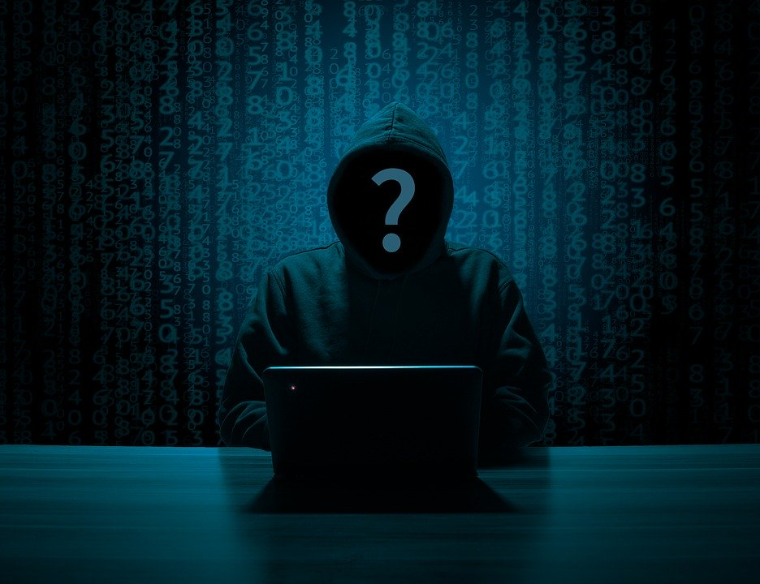
Information security
The Breach: In 2016, Yahoo announced that 3 billion records were hacked.
The Loss: All customer names, email addresses, telephone numbers and dates of birth.
The Access: Vulnerability to a phishing scheme.
The Consequences: Yahoo agreed to pay $117.5 million to settle a class-action lawsuit.

Slide 3
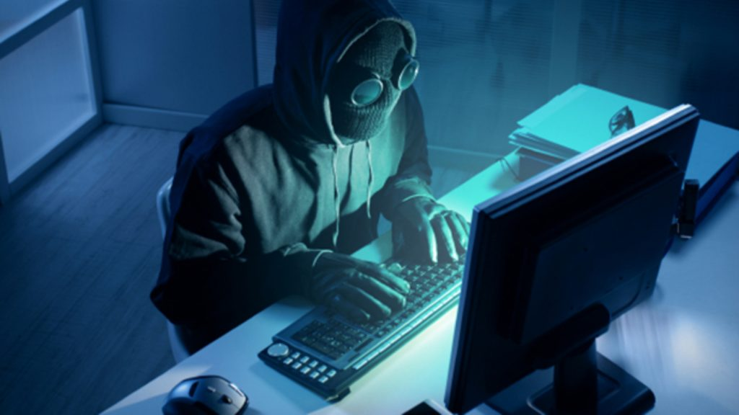
Information security
The Breach: In 2018, Marriott disclosed to the public that 383 million records were hacked.
The Loss: Guest names, addresses, contact information, passport numbers, and payment information.
The Access: malware on the Starwood IT systems.
The Consequences: $124 Million fine under the General Data Protection Regulation (GDPR.

Slide 4
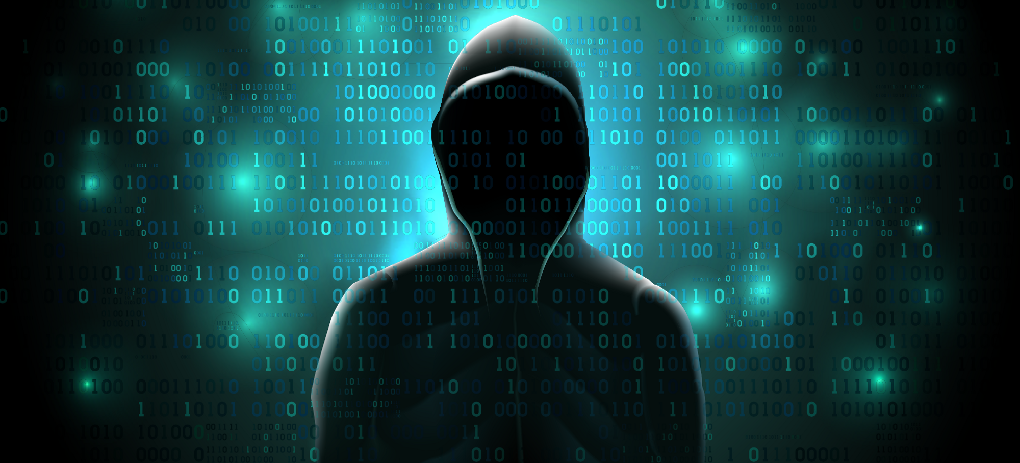
Information security
The Breach: In 2014, eBay revealed that 145 million accounts were hacked.
The Loss: Names, addresses, dates of birth and encrypted passwords of every eBay account was exposed.
The Access: Suspected social engineering or phishing.
The Consequences: Revenue decline.

Slide 5

Information security
Information security focuses on preventing such breaches.
“Information security, also known as Infosec, is a process of formulating strategies, tools, and policies to detect, document, prevent, and combat threats targeted on digital and non-digital information devices.” (EC-Council, 2018)

Slide 6

Legislature
The legal framework for ensuring information security, begins with the legislative body of federal laws that must be adhered to. Those laws can be grouped into 6 errors.

Slide 7
Legislature
Privacy: Everyone has the right to privacy and companies must ensure the privacy is upheld
United States – European Union Safe Harbor and Privacy Shield: In a court ruling, the transferring of personal information where the only control is that of Safe Harbor self-certification is illegal.

Slide 8
Legislature
Employer and Employee Rights: Employee rights and employer rights related to confidentiality, privacy and safety should be fully explained and upheld through business processes and technology systems.

Slide 9
Legislature
Computer Fraud and Abuse Laws: The CFAA US law prohibits the distribution of malware, committing hacking offenses, unauthorized access to computer systems, denial-of-service attacks, and trafficking and selling of authentication related items such as passwords and usernames.

Slide 10
Legislature
Records Retention: Certain documents including, the minutes of company board meetings, audited financial records and contracts of employment must be tightly controlled, retained over a predefined timeframe, and made available for inspection for audit.

Slide 11
Legislature
Intellectual Property Rights and Copyright: Intellectual Property Rights protect individual and company rights regarding creative works. Copyright law any form of written and digital work.

Slide 12
Information security
The International Standards Organization (ISO) has developed standards of information security management the meet legislative and business requirements.

Slide 13
ISO/IEC 27000 series
Within the International Standards Organization (ISO) there is a range the covers security management recommendations and best practices known as the ISO/IEC 27000 series.

Slide 14
ISO/IEC 27000 series can be adopted to help build an fully complaint and effective information security management system (ISMS).

Slide 15
Additional standards
Payment Card Industry Data Security Standard (PCI-DSS): Consists of 12 compliance requirements grouped into six control objectives designed to keep customer credit card data should be safe.
Health Insurance Portability and Accountability Act(HIPAA): laws that apply to all companies that have access to health information and imposes rules for handling of personal health information.

Slide 16
Through the adherence of legislative requirements and Industry standards, we can keep customers and the business safe from threats.

Slide 17

References
Campbell, Tony. (2016). Practical information security management: a complete guide to planning and implementation. [Books24x7 version]. https://6o347812i-mp03-y-https-library-books24x7-com.prx-herzing.lirn.net/toc.aspx?bookid=125404
Chabrow, E. (2014, July 17). EBay Sees Revenue Decline Due to Breach. Retrieved from https://www.bankinfosecurity.com/ebay-sees-fewer-sales-due-to-breach-a-7074
EC-Council. (2018, March 20). What Information Security Is and Why It Is Important: EC-Council Official Blog. Retrieved from https://blog.eccouncil.org/what-information-security-is-and-why-it-is-important/
ISO/IEC 27001 - Information security management. (2020, April 03). Retrieved July 12, 2020, from https://www.iso.org/isoiec-27001-information-security.html

Slide 18
References
Leonhardt, M. (2019, December 27). The 10 biggest data hacks of the decade. Retrieved from https://www.cnbc.com/2019/12/23/the-10-biggest-data-hacks-of-the-decade.html
O'Flaherty, K. (2019, March 11). Marriott CEO Reveals New Details About Mega Breach. Retrieved from https://www.forbes.com/sites/kateoflahertyuk/2019/03/11/marriott-ceo-reveals-new-details-about-mega-breach/
Riley, C. (2019, July 09). UK proposes another huge data fine. This time, Marriott is the target. Retrieved from https://www.cnn.com/2019/07/09/tech/marriott-data-breach-fine/index.html
Swinhoe, D. (2020, April 17). The 15 biggest data breaches of the 21st century. Retrieved from https://www.csoonline.com/article/2130877/the-biggest-data-breaches-of-the-21st-century.html

Slide 19
References
Quittner, J. (2014, May 30). An Inside Look at the Latest Hack Attack Against EBay. Retrieved from https://www.inc.com/jeremy-quittner/new-details-emerge-on-ebay-hack-attack.html

